Slide 1
DIVISION OF A LINE SEGMENT

Slide 2
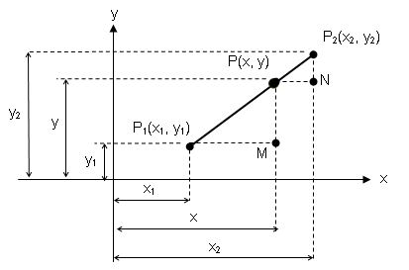
DIVISION OF A LINE SEGMENT
POINT OF DIVISION – is a point which divides a line segment to a given ratio.

Slide 3




By Similar Triangles:
x – x₁ = rx₂ – rx
rx + x = x₁ + rx₂
x( 1 + r ) = x₁ + rx₂
Solving for x solving for y

Slide 4
Examples:
Determine the point of division from P1(1, 7) to P2(6, -3) if r = 2/3.
Find the points of trisection of the line segment joining the points (3, -3) and (-3, 6).
The line segment from (1, 4) to (2, 1) is extended a distance equal to twice its length. Find terminal point.
Find the midpoint of the segment joining (7, -2) and (-3, 5).
The line segment joining (-5, -3) and (3, 4) is to be divided into five equal parts. Find the point of division closest to (-5, -3).
The midpoints of the sides of a triangle are A(3, 0),
B(5, 2), and C(2, 2), find the coordinates of the vertices.

Slide 5
End of Discussion

Slide 6
Examples:
Determine the point of division from P1(1, 7) to P2(6, -3) if r = 2/3.
Find the points of trisection of the line segment joining the points (3, -3) and (-3, 6).
The line segment from (1, 4) to (2, 1) is extended a distance equal to twice its length. Find terminal point.
The midpoints of the sides of a triangle are A(3, 0), B(5, 2), and C(2, 2), find the coordinates of the vertices.

